Slide 1
Introduction to Clean Finance Structure

Slide 2
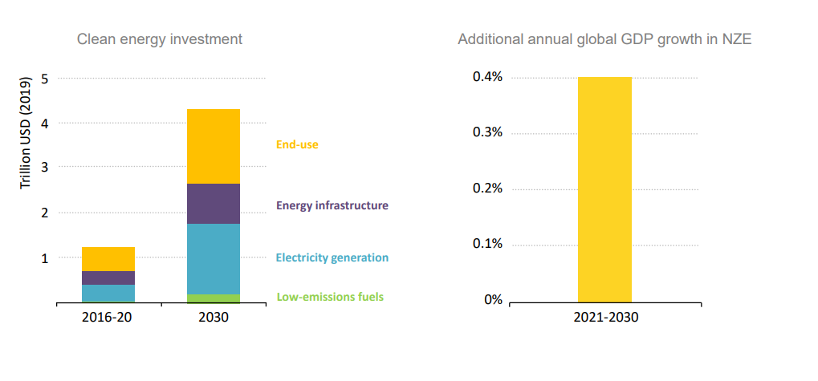
Clean Energy Investment (Global)
Source: IEA Net zero report https://iea.blob.core.windows.net/assets/7ebafc81-74ed-412b-9c60-5cc32c8396e4/NetZeroby2050-ARoadmapfortheGlobalEnergySector-SummaryforPolicyMakers_CORR.pdf

Slide 3
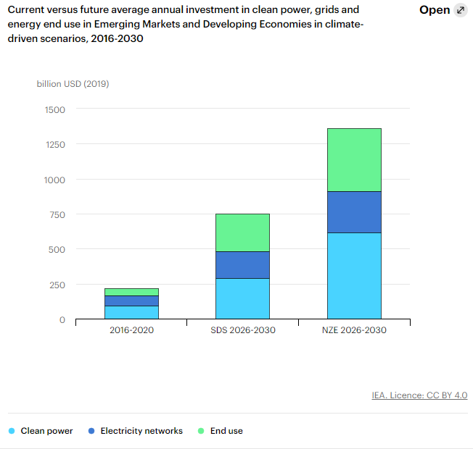
Emerging Market and Developing Economy (Excluding China) Only
$1tr/year gap
Source: https://www.iea.org/reports/financing-clean-energy-transitions-in-emerging-and-developing-economies/financing-clean-power-efficiency-and-electrification#abstract

Slide 4
The ‘Big Push’
Let’s call an internationally-coordinated attempt to meet net zero investment needs across state, private developed and developing countries a ‘big push’. What would it take to finance a big push

Slide 5
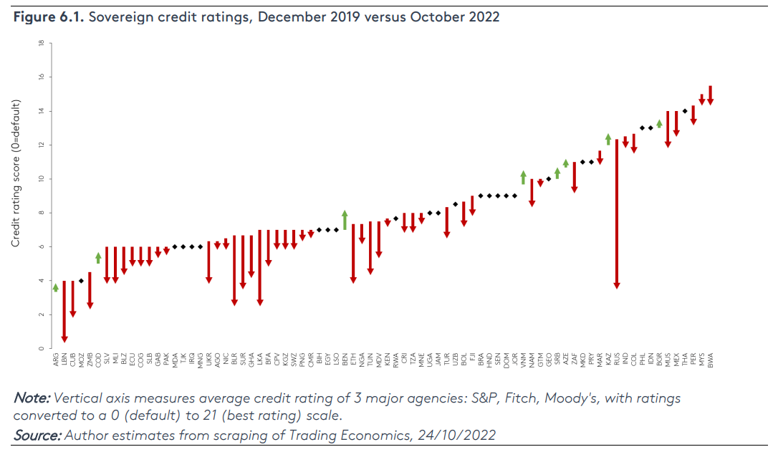
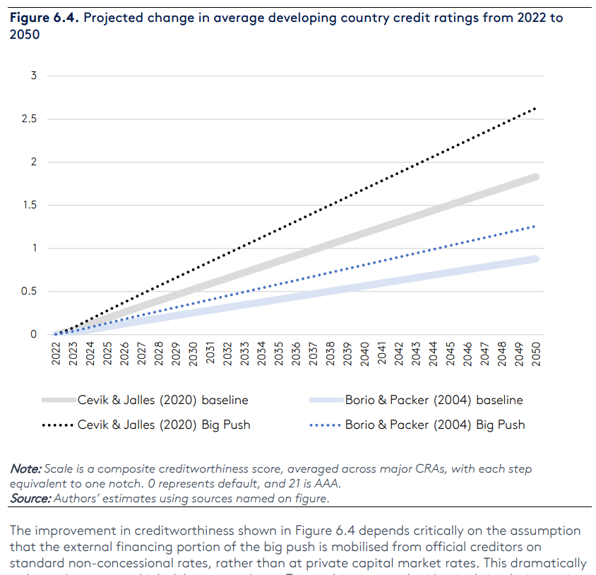
A big push can improve developing country credit ratings…
Current Ratings
Big push on climate: (slightly better developing country sovereign risk rates– including climate risks as well as fiscal position)

Slide 6
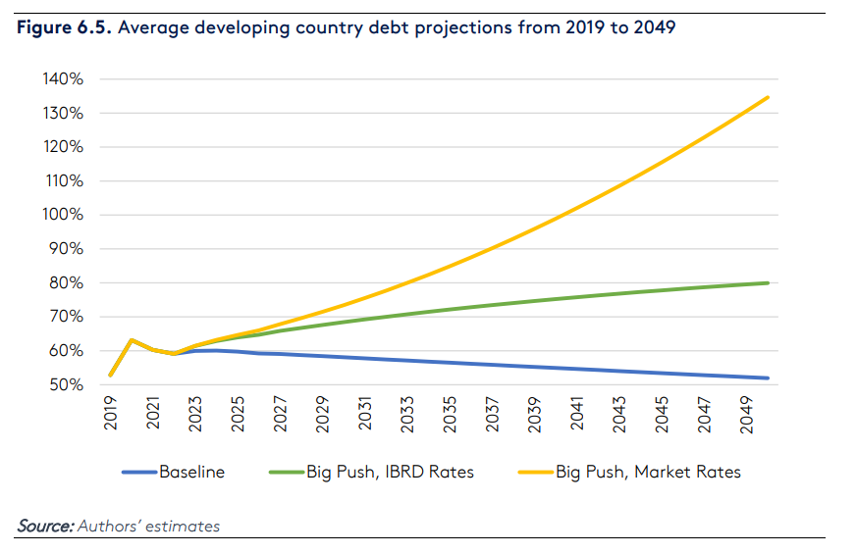
.. But only if at IBRD rates: not at market rates
Big push increases debt, but only somewhat at IBRD interest rates
At Market rates it leads to a compound-interest problem

Slide 7
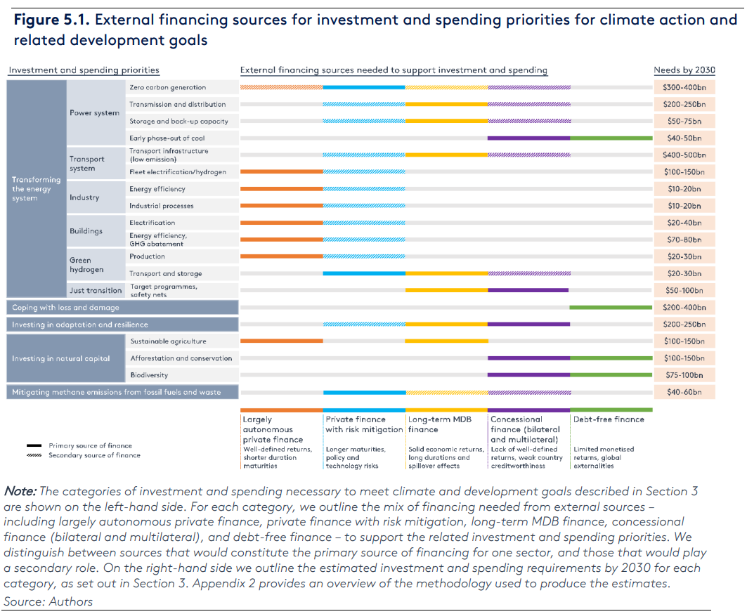
$2.5tr

Slide 8
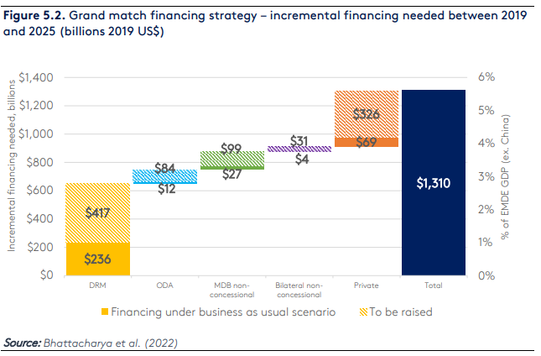

Slide 9
